Slide 1
PowerCLI 201
CODE1744LV
From the Shell to Writing Scripts
Justin Sider
Chief PowerShell Officer – Belay Technologies
#CODE1744LV
Broadcom Proprietary and Confidential. Copyright © 2024 Broadcom.
All Rights Reserved. The term “Broadcom” refers to Broadcom Inc. and/or its subsidiaries.

Slide 2
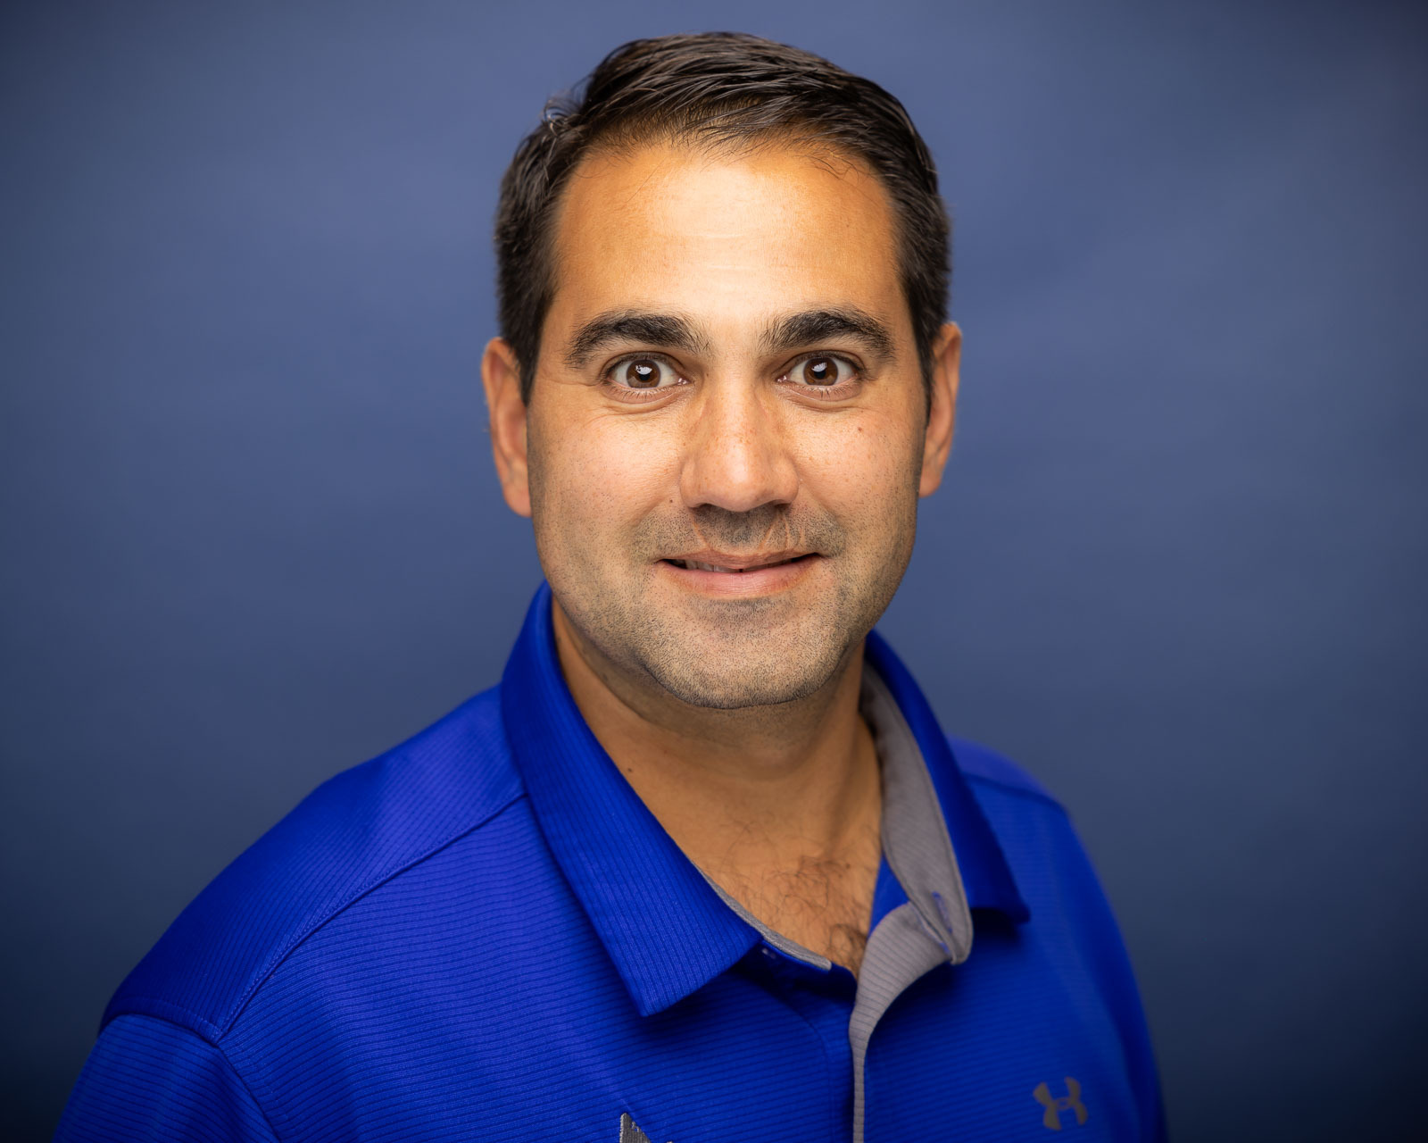
Justin Sider
Blog
https://invoke-automation.blog
GitHub
https://github.com/jpsider
Twitter(X)/Slack
Jpsider
VMware Community
vExpert, VMUG leader, {Code} Coach, VMUG BOD
Chief Information Officer – Belay Technologies
Broadcom Proprietary and Confidential. Copyright © 2024 Broadcom.
All Rights Reserved. The term “Broadcom” refers to Broadcom Inc. and/or its subsidiaries.

Slide 3
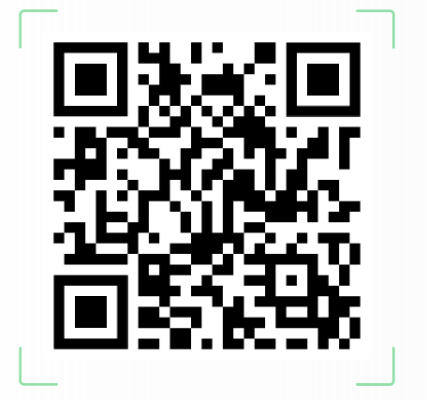
Takeaways
Review the Basics
Understand the Developer Center
Convert UI Actions to PowerCLI code
Slides & Code

Slide 4
Agenda
PowerShell Basics
What is a Script?
VMware Developer Center
PowerShell vs. C# vs. .Net
Converting Developer Center Output to Useable PowerShell/PowerCLI
Get-Member
Get-Help
Related Links
Resources

Slide 5
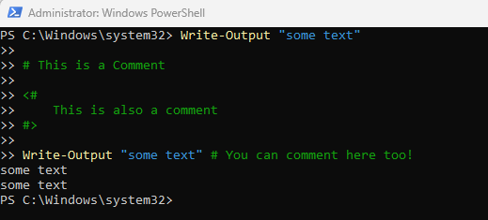
PowerShell 101
Verb-Noun (Functions)
Examples:
Get-Process
Write-Output
Get-VM
Restart-GuestOS
Approved Verbs:
Get-Verb

Slide 6
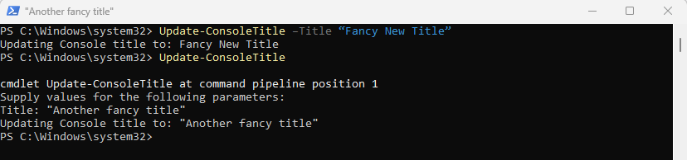
PowerShell 102
WTF – What the function?
Functions & Parameters
<Function Name> + <Parameter Name> + <Parameter Value>
Get-Process –Name “Powershell”
<Function Name> + <Parameter Name> + <Parameter Value>
Update-ConsoleTitle –Title “Fancy New Title”
If a Parameter is required, PowerShell will ask you for it!

Slide 7

PowerShell 150
Get to know your Objects
Objects
A collection of Data that represents an Item.
In PowerShell and Object is made up of 3 types of Data
Object Type
What am I?
Methods
What can you do to me?
Properties
What are the things that describe me?

Slide 8
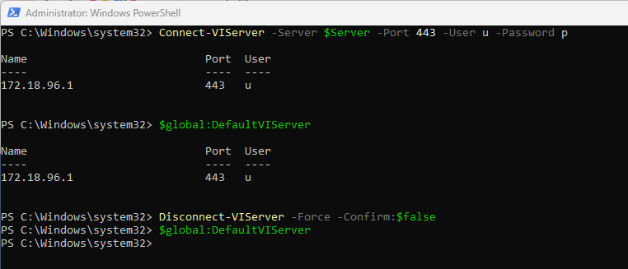
PowerCLI 101
The star of the show!
Getting Started with PowerCLI
Install the PowerCLI module
Open Powershell
Install-Module Vmware.PowerCLI
Wait a little while ☺
Connect to a vCenter
Connect-VIServer –name myvcenter –Username “administrator” –Password “VMware1!”
$Global:DefaultVIServer
Disconnect-VIServer –Force –Confirm:$false

Slide 9
What is a Script?
A script is a plain text file with one or more PowerShell Commands.
PowerShell scripts have a .ps1 file extension
Yes, You can pass in Parameters!
Not today! - but you should do some research!
Execution Policy
Comment based help
Running Scripts against Remote Computers
Exit codes
Scope
Dot Sourcing
And more!

Slide 10
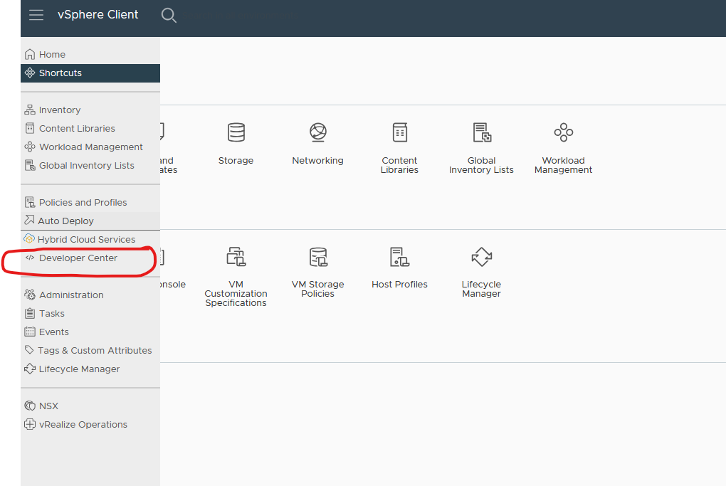
VMware Developer Center
Best thing since sliced bread!
Great tool for new developers! – Yes that means you!

Slide 11
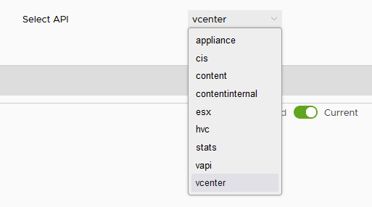
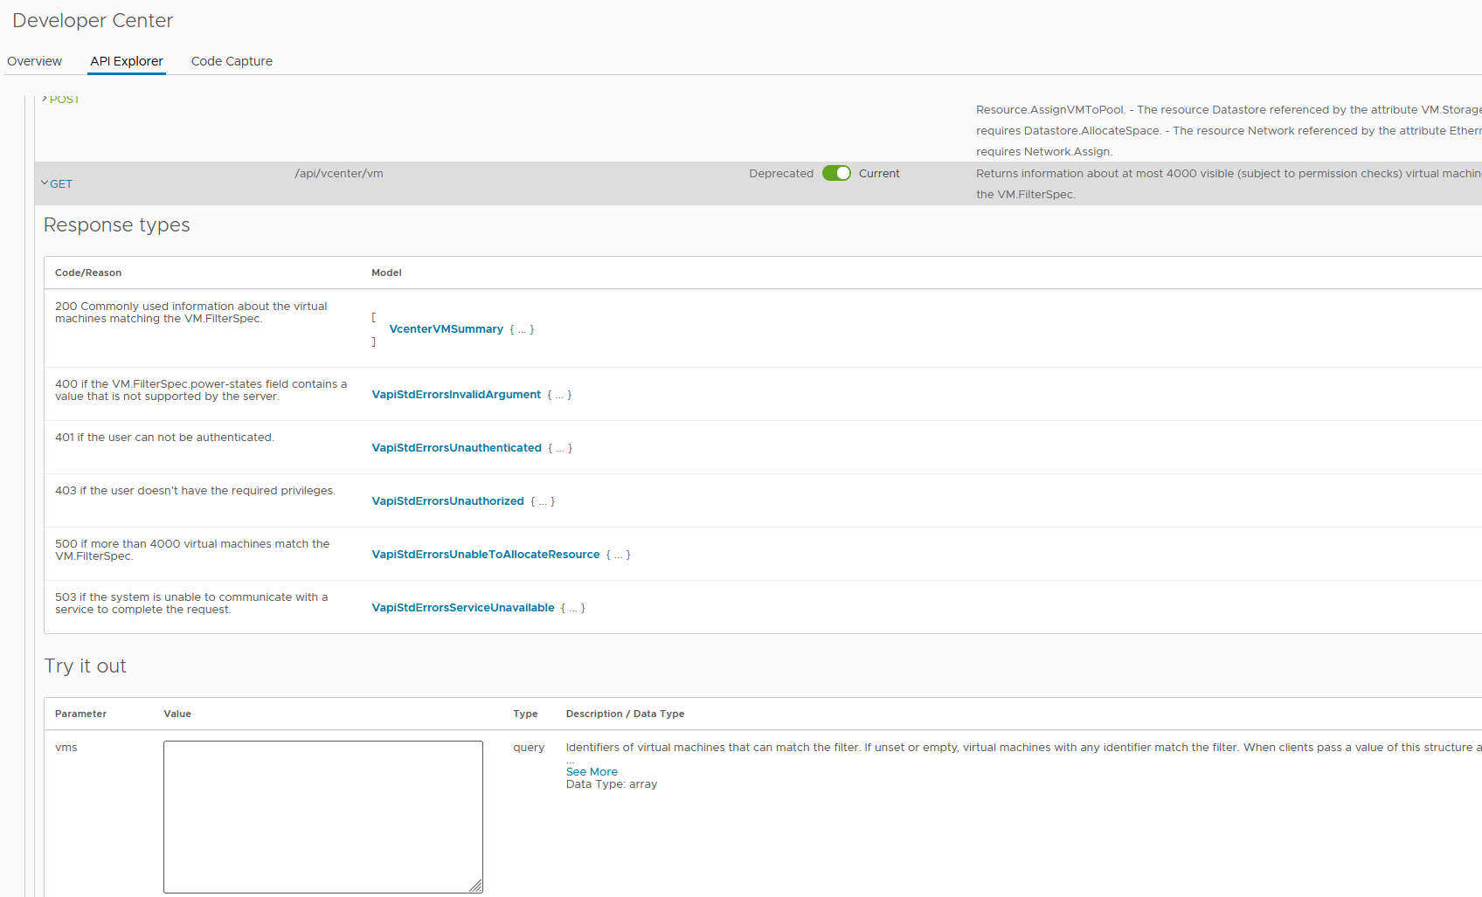
VMware Developer Center
API Explorer
Explore the REST endpoints of multiple vSphere API’s

Slide 12
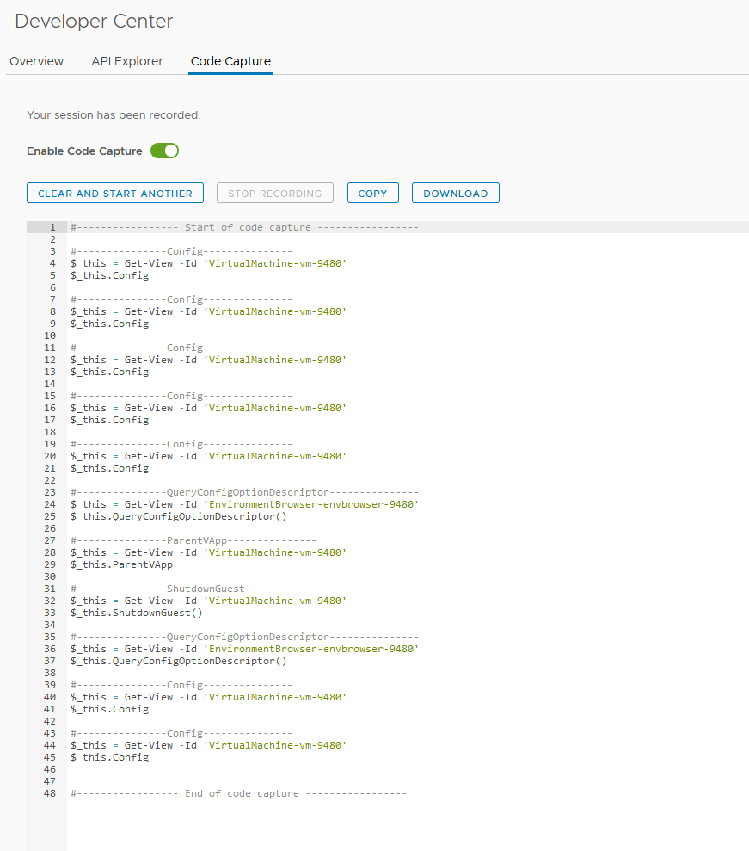
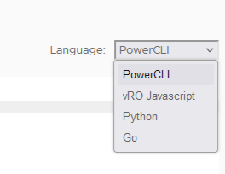
VMware Developer Center
Code Capture
Perform UI actions
Spits out “code”
Multiple language options!

Slide 13


VMware Developer Center
Rest vs. Soap
vs.

Slide 14
PowerShell vs. C# vs. .NET
Generally speaking…
PowerShell
Scripting language
Non-Compiled
C#
Programming Language Compiled
.NET (dot net)
Framework and Libraries
But there is more to the story …
Check out the PowerCLI 301 session!
Wednesday or Thursday

Slide 15



Converting Developer Center Output to useable PowerShell/PowerCLI
This should be easy…. Thank a PowerCLI developer today!
Expectation
Reality

Slide 16
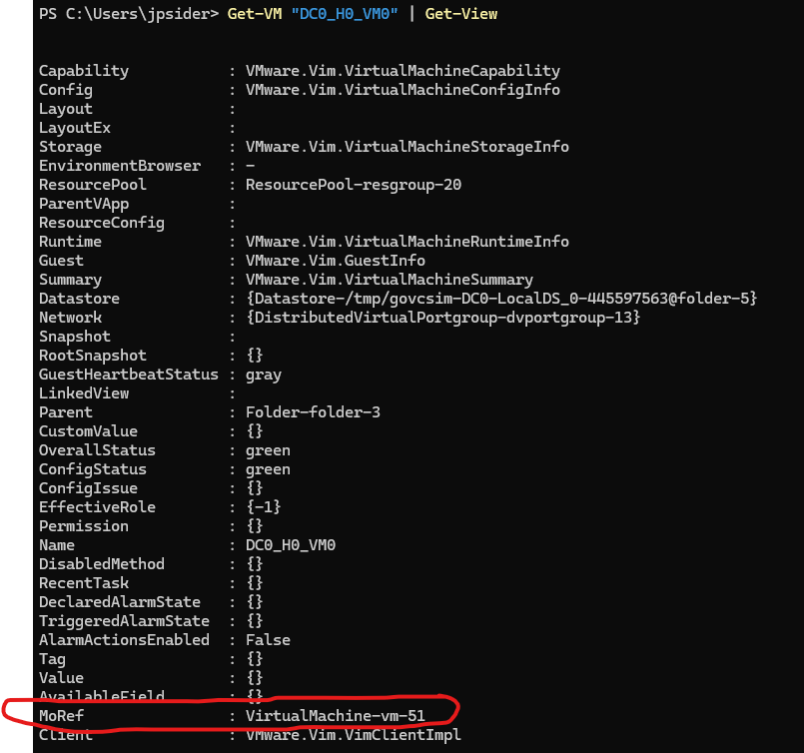
Converting Developer Center Output to useable PowerShell/PowerCLI
Get-View FTW!
MoRef – Manage Object Reference
Learn to love it!

Slide 17
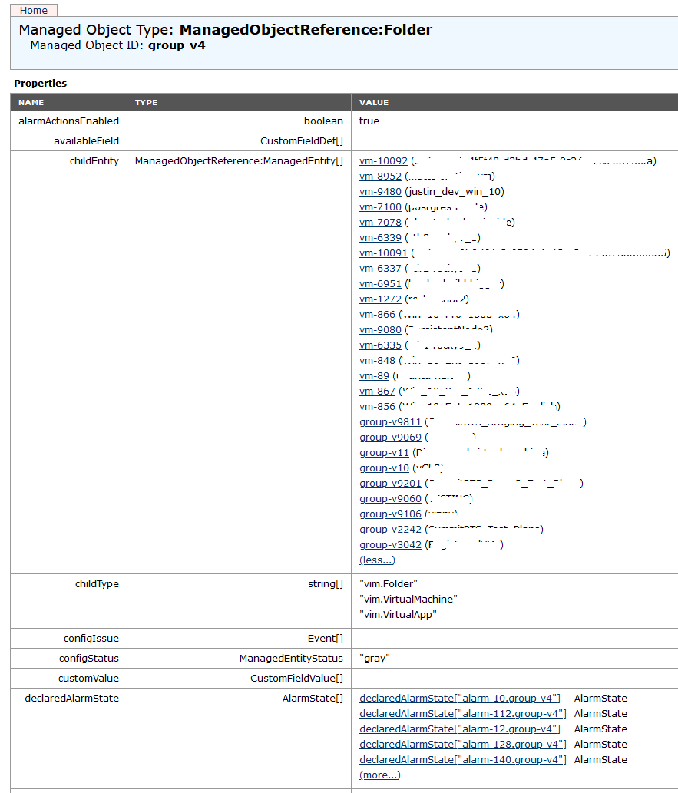
Managed Object Browser (the MOB)
Careful talking about this in Vegas
Https://<vcenter>/mob
Reality

Slide 18
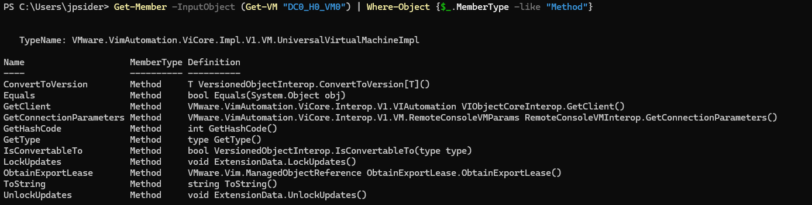
Get-Member
What methods are available?
Get-Member –InputObject (Get-VM “DC0_H0_VM0”) | Where-Object {$_.MemberType -like "Method"}
Uhhhhhh…….. Where is the ShutdownGuest Method?

Slide 19
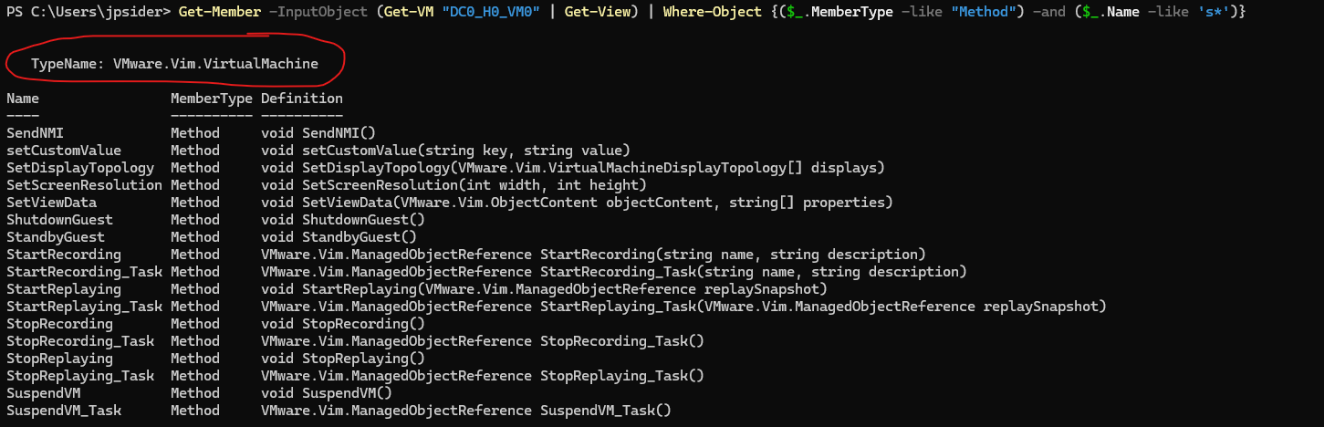
Get-Member
Good thing this is a 200 level session!
Get-Member –InputObject (Get-VM “DC0_H0_VM0” | Get-view) | Where-Object {($_.MemberType -like "Method“) –and ($_.name –like ‘*s’)}

Slide 20
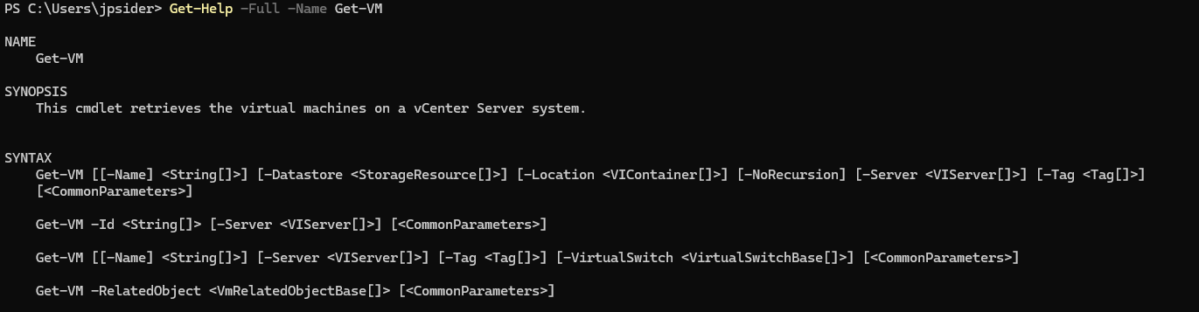
Get-Help
Use this feature!

Slide 21
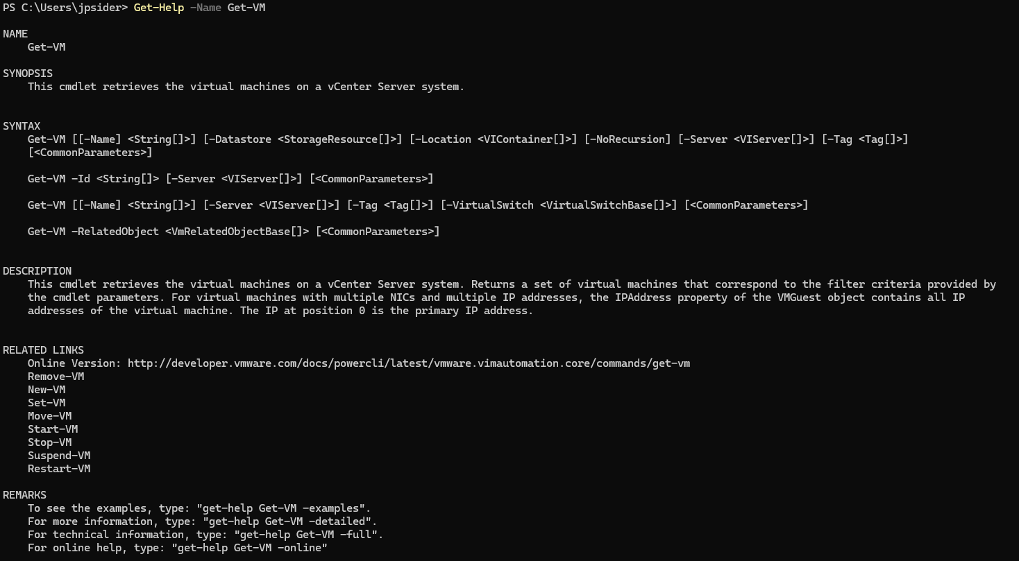
Related Links
Need more information – or related commands?

Slide 22
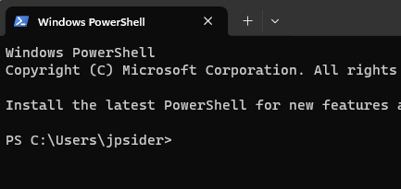

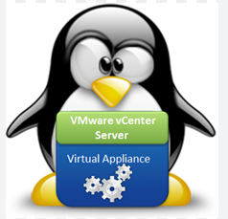

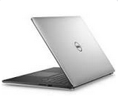
Demo Environment
Lets go Live!

Slide 23
Resources
Developer Documentation:
https://developer.broadcom.com/
VMware Forums
https://community.broadcom.com/home
Slides & Code

Slide 24
PowerCLI Lyrics
Thanks to Justin Brant & ChatGPT
*(Verse 1)*
Yo, I'm in the datacenter, making moves with precision,
Got the PowerCLI, scripting's my decision,
VMware on lock, no manual intervention,
Automate the tasks, that’s my daily mission.
From snapshots to clones, I’m the virtual magician,
Deploying those VMs like I’m on a fast mission,
Handling workloads, no need for supervision,
My scripts so clean, they need no revision.
*(Chorus)*
PowerCLI, yeah, I’m in control,
Automating everything, that’s how I roll.
No more clicking through, I’ve got the goal,
Scripts on fire, yeah, watch them unfold.
*(Verse 2)*
I set up the network, configure every switch,
In the vSphere world, I’m the one who’s rich,
Datastores connected, never miss a hitch,
With PowerCLI, I’m the one they can’t ditch.
Managing clusters, balancing the load,
Disaster recovery? I’m writing that code.
Snapshots on schedule, backups in mode,
In the world of scripts, I’m the one that’s road.
*(Chorus)*
PowerCLI, yeah, I’m in control,
Automating everything, that’s how I roll.
No more clicking through, I’ve got the goal,
Scripts on fire, yeah, watch them unfold.
*(Bridge)*
From vMotions to HA, I’ve got it in my hand,
Scaling up the infra, making every stand.
Command after command, in the terminal I land,
PowerCLI’s my weapon, and I’m in demand.
*(Chorus)*
PowerCLI, yeah, I’m in control,
Automating everything, that’s how I roll.
No more clicking through, I’ve got the goal,
Scripts on fire, yeah, watch them unfold.
*(Outro)*
So when you see me in the datacenter, know I’ve got the keys,
Running those commands, making life a breeze.
With PowerCLI, I’m doing it with ease,
In the world of IT, I’m the king of these trees.

Slide 25
Please take your survey.
Slides & Code
Thank you!
Join the VMware {code} Hackathon tonight!
7-11pm Hall G
Broadcom Proprietary and Confidential. Copyright © 2024 Broadcom.
All Rights Reserved. The term “Broadcom” refers to Broadcom Inc. and/or its subsidiaries.

